Slide 1

Operating Systems Design​ Session 29 & 30: TLB and Segmentation
19CS2106R​
© 2020 KL University

Slide 2
Translation look aside buffer (TLB)
Drawbacks of Paging
Size of Page table
Effective access time
Translation look aside buffer
A Translation look aside buffer can be defined as a memory cache which can be used to reduce the time taken to access the page table again and again.
TLB follows the concept of locality of reference which means that it contains only the entries of those many pages that are frequently accessed by the CPU.

Slide 3
Translation look aside buffer (TLB)
Given a virtual address, the processor examines the TLB if a page table entry is present (TLB hit), the frame number is retrieved and the real address is formed.
TLB hit is a condition where the desired entry is found in translation look aside buffer. If this happens then the CPU simply access the actual location in the main memory.
However, if the entry is not found in TLB (TLB miss) then CPU has to access page table in the main memory and then access the actual frame in the main memory.
Therefore, in the case of TLB hit, the effective access time will be lesser as compare to the case of TLB miss.

Slide 4
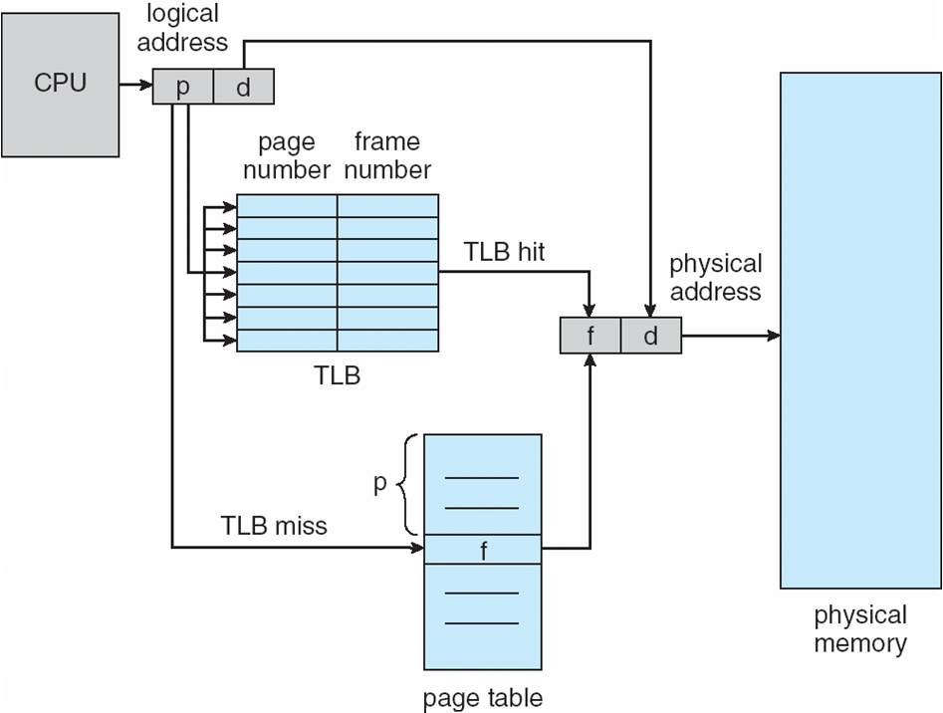
Translation look aside buffer (TLB)

Slide 5
VPN = (VirtualAddress & VPN_MASK) >> SHIFT
(Success, TlbEntry) = TLB_Lookup(VPN) if (Success == True) // TLB Hit
if (CanAccess(TlbEntry.ProtectBits) == True)
Offset = VirtualAddress & OFFSET_MASK
PhysAddr = (TlbEntry.PFN << SHIFT) | Offset
Register = AccessMemory(PhysAddr)
else
RaiseException(PROTECTION_FAULT)
else // TLB Miss
PTEAddr = PTBR + (VPN * sizeof(PTE))
PTE = AccessMemory(PTEAddr) if (PTE.Valid == False)
RaiseException(SEGMENTATION_FAULT) else if (CanAccess(PTE.ProtectBits) == False)
RaiseException(PROTECTION_FAULT) else
TLB_Insert(VPN, PTE.PFN, PTE.ProtectBits)
RetryInstruction()
Figure 19.1: TLB Control Flow Algorithm
Translation look aside buffer (TLB)

Slide 6
Translation look aside buffer (TLB)
If the probability of TLB hit is P% (TLB hit rate) then the probability of TLB miss (TLB miss rate) will be (1-P) %.
Therefore, the effective access time can be defined as;
EAT = P (t + m) + (1 - p) (t + k.m + m)
Where, p → TLB hit rate,
t → time taken to access TLB,
m → time taken to access main memory k = 1, if the single level paging has been implemented.
By the formula, we come to know that
Effective access time will be decreased if the TLB hit rate is increased.
Effective access time will be increased in the case of multilevel paging.

Slide 7
Translation look aside buffer (TLB)
Consider a paging hardware with a TLB.
Assume that the entire page table and all the pages are in the physical memory.
It takes 10 milliseconds to search the TLB and 80 milliseconds to access the physical memory.
If the TLB hit ratio is 0.6, the effective memory access time (in milliseconds) is
EAT = P (t + m) + (1 - p) (t + k.m + m)
Effective Access Time (EAT) = 0.6 ( 10 + 80 ) + 0.4 ( 10 + 80 + 80 )
= 90 X 0.6 + 0.4 X 170
= 122

Slide 8
Segmentation

Slide 9
Segmentation
Virtual address space of process divided into separate logical segments
segmentation allows the OS to place each one of those segments in different parts of physical memory.
Every segment will have Segment Descriptor.
Base
Limit
Access
Heap
Stack
Data
Text
Access | Limit
Base Address

Slide 10
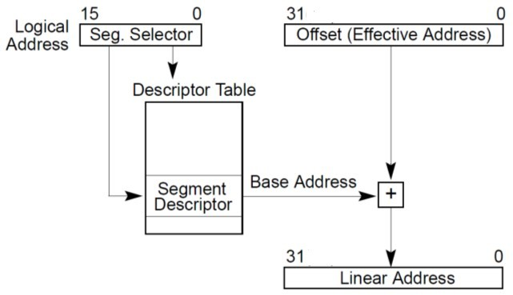
Segmentation
Let’s first assume no paging in the system
User generates logical addresses
These addresses consist of a segment number and an offset into the segment.
Each segment associated with a segment selector and offset.
Use segment number to index into a table
Add the offset to the base and generate the physical address

Slide 11
Segmentation
0x3000
Segment | Base | Limit
0 | - | -
1 | 1000 | 1000
2 | 4000 | 500
3 | 8000 | 1000
4 | 9000 | 1000
Heap
Stack
Data
Text
0x3000
pointer to descriptor table
10000
9000
8000
4500
4000
3000
2000
1
+
segment register (eg %CS)
1000
100
0
offset register (eg %eip)
Address Map of Process
11

Slide 12
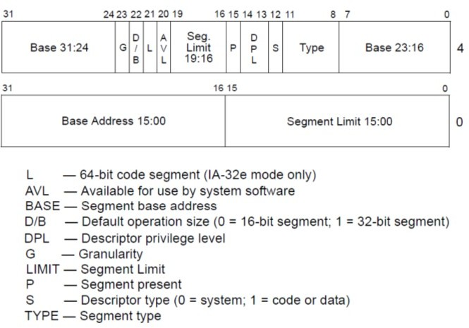

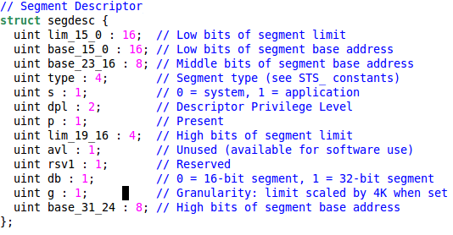
Segment Descriptor

Slide 13
GDT
Global Descriptor Table (GDT) Stored in memory
Pointed to by GDTR (GDT Register)
lgdt (instruction used to load the GDT register)
Similar table called LDT present in x86 (not used by xv6!)
Segment Descriptor
Segment Descriptor
Segment Descriptor
Segment Descriptor
Segment Descriptor
Segment Descriptor
base
size
47 16
0
GDTR
Size : size of GDT Base : pointer to GDT
GDT
13

Slide 14
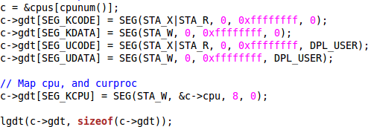
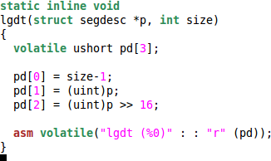
Loading the GDTR in XV6
Instruction LGDT
Each CPU has its own GDTR
14

Slide 15
Segmentation + Paging in x86
Logical Address
(segment
+
offset)
48 Bits
Linear
Physical
CPU
Segmentation Unit
Address
32 Bits
Paging Unit
Address
32 Bits
Physical Memory
15

Slide 16
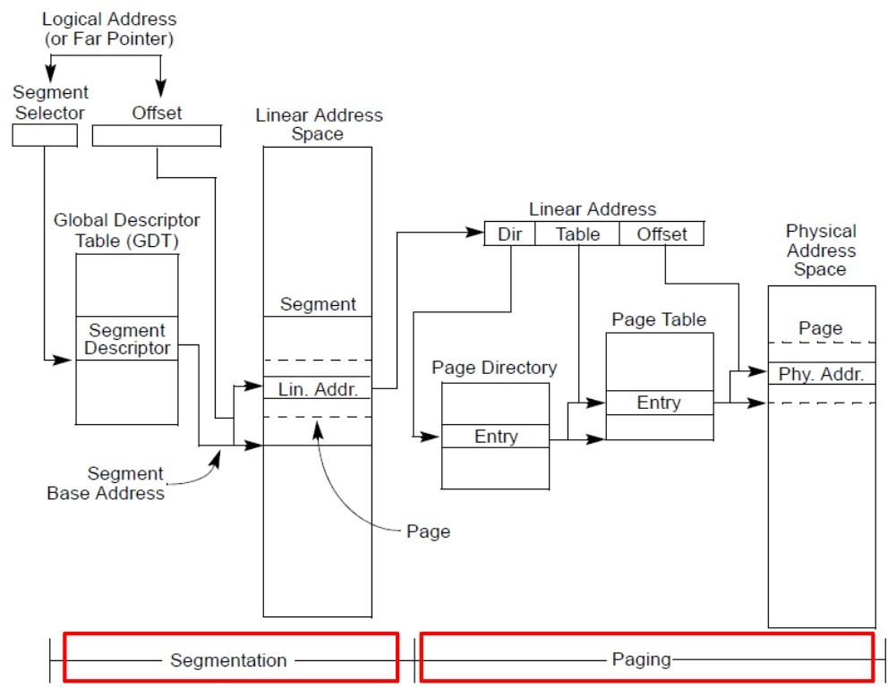

Segmentation + Paging in x86
Initialized once common for all processes
Each proces has one
16

Slide 17
Memory Management Method

Slide 18
Methods Review
Uni programming
Multi Programming
Swapping
Segmentation
Paging
Hierarchical Paging
Demand Paging
Segmentation + Paging
Regions + Paging
TLB

Slide 19
Methods Review
Uni programming
Multi Programming
Swapping
Segmentation
Paging
Hierarchical Paging
Demand Paging
Segmentation + Paging
Regions + Paging
TLB
0KB
Operating System
(code, data, etc.)
64KB
Current
Program
(code, data, etc.)
max

Slide 20
Methods Review
0KB
Operating System
(code, data, etc.)
64KB
Uni programming
Multi Programming
Swapping
Segmentation
Paging
Hierarchical Paging
Demand Paging
Segmentation + Paging
Regions + Paging
TLB
Free
128KB
Process C
(code, data, etc.)
192KB
Process B
(code, data, etc.)
256KB
Free
320KB
Process A
(code, data, etc.)
448KB
Free
512KB
Physical Memory
Process D
(code, data, etc.)
164KB

Slide 21
Methods Review
0KB
Operating System
(code, data, etc.)
64KB
Uni programming
Multi Programming
Swapping
Segmentation
Paging
Hierarchical Paging
Demand Paging
Segmentation + Paging
Regions + Paging
TLB
Free
128KB
Process C
(code, data, etc.)
192KB
Process B
(code, data, etc.)
256KB
Free
Swap in and Swap Out
320KB
Process A
(code, data, etc.)
448KB
Free
512KB
Physical Memory
Process D
(code, data, etc.)
164KB

Slide 22
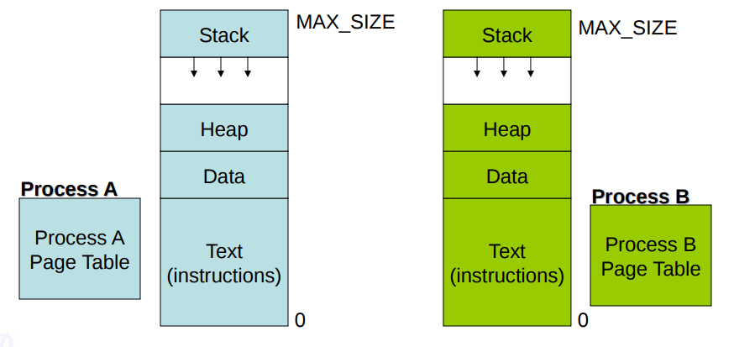
Methods Review
Stack
Data
Text
Data
Text
Uni programming
Multi Programming
Swapping
Segmentation
Paging
Hierarchical Paging
Demand Paging
Segmentation + Paging
Regions + Paging
TLB

Slide 23
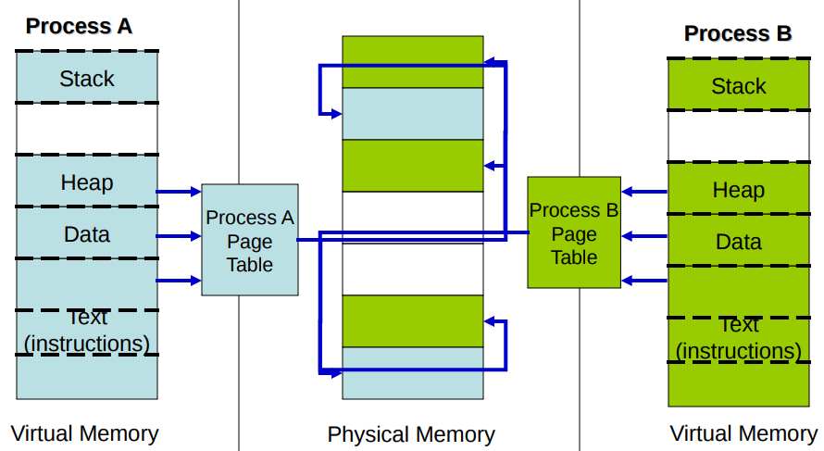
Methods Review
Uni programming
Multi Programming
Swapping
Segmentation
Paging
Hierarchical Paging
Demand Paging
Segmentation + Paging
Regions + Paging
TLB

Slide 24
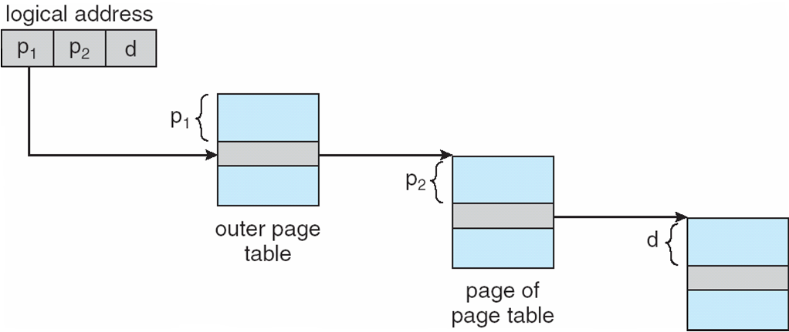
Methods Review
Uni programming
Multi Programming
Swapping
Segmentation
Paging
Hierarchical Paging
Demand Paging
Segmentation + Paging
Regions + Paging
TLB

Slide 25
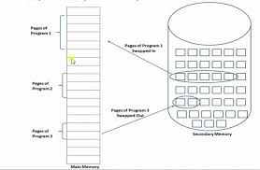
Methods Review
Uni programming
Multi Programming
Swapping
Segmentation
Paging
Hierarchical Paging
Demand Paging
Segmentation + Paging
Regions + Paging
TLB

Slide 26
Methods Review
Uni programming
Multi Programming
Swapping
Segmentation
Paging
Hierarchical Paging
Demand Paging
Segmentation + Paging
Regions + Paging
TLB

Slide 27
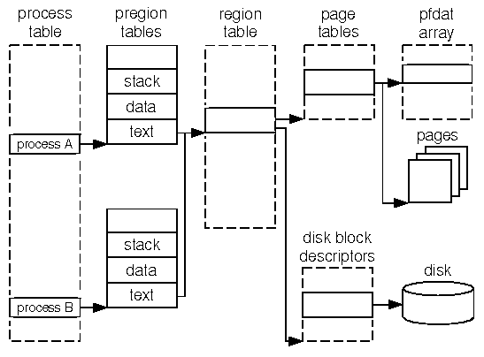
Methods Review
Uni programming
Multi Programming
Swapping
Segmentation
Paging
Hierarchical Paging
Demand Paging
Segmentation + Paging
Regions + Paging
TLB

Slide 28
Methods Review
Uni programming
Multi Programming
Swapping
Segmentation
Paging
Hierarchical Paging
Demand Paging
Segmentation + Paging
Regions + Paging
TLB

Slide 29
XV6 Memory Management Method

Slide 30
XV6 Method
XV6 Loads the process which will be in Regions
Uses Hierarchical Paging

